Slide 1

Customer Personality Analysis
Yaser Hussein Al-Batyeh

Slide 2
Project Objective(s) & Deliverables
Objective(s)
Collecting data for companies' customers and its product .
Main personal factors that influence buying a product.
Getting accurate prediction model for spending money for product.
Deliverables
Notebook that obtain the best prediction
Presentation
Report

Slide 3
Describe the Dataset
Dataset contains customer personal feature, product types, Buying offers from the customer and place of purchases made by customer.
Dataset contains 29 attributes and 2,240 customers. We get this dataset from marketing company in UK.

Slide 4
Stat of art
The ones how work this dataset solve it as cluster problem.
I solve it as regression problem to predict values.

Slide 5
Problem Statement
Customer Personality Analysis is a detailed analysis of a company’s ideal customers. It helps a business to better understand its customers and makes it easier for them to modify products according to the specific needs, behaviors and concerns of different types of customers.
Customer personality analysis helps a business to modify its product based on its target customers from different types of customer segments.

Slide 6
ML type?
This is a regression problem.
We need to predict a customer total amount spent on products .
And how much a customer will spend on a specific kind of product.

Slide 7
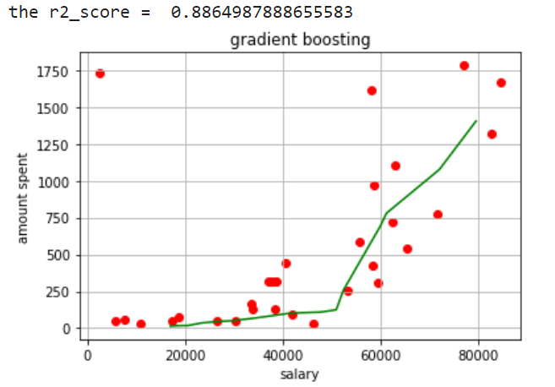
Regression model
The R2_score of 0.88 is achieved for total amount spent by a customer.
I use a gradient Boosting regression model for this problem because it give me the highest accuracy prediction.

Slide 8
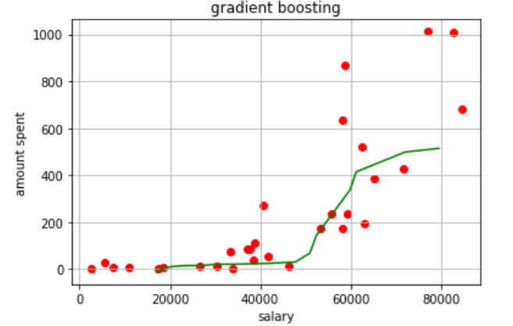
Regression model
The R2_score of 0.79 is achieved for amount spent on specific product by a customer.

Slide 9
Other regression models
Model | R2_score for Total | R2_score for specific
XG Boost | 0.88463 | 0.79360
Linear regression | 0.83171 | 0.75609
Ridge regression | 0.83153 | 0.75543
Lasso regression | 0.83019 | 0.74749
Polynomial regression | 0.83171 | 0.75609
I use deferent models, they almost give me the same result.

Slide 10
Why we need amount spent prediction?
For marketing companies, it is important to read their customers specially for modifying products according to the specific needs of customers.
So, knowing the amount spent by a customer will make companies offer its products for customers that will most likely buy it.
Also, offering products similar to products he/she bought before.

Slide 11

Thank you
Do you have any question?

